Slide 1
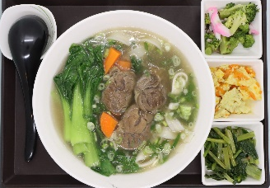
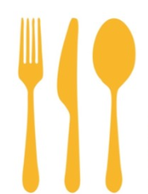


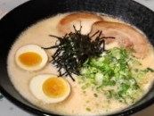
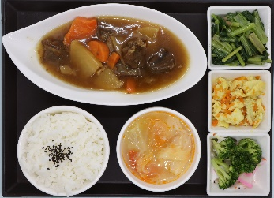
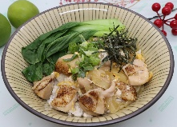
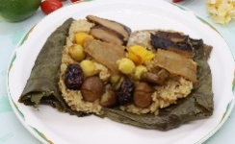
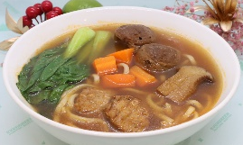
Menu
$320 PER SET
1 | Braised Beef Noodle Soup
2 | Stewed Beef Noodle Soup
3 | Tonkotsu Ramen
4 | Spaghetti with Clams in Pesto
 | Rice-2
10 | Crystal Sugar Braised Chicken/with Rice
11 | Taiwanese Three Cup Chicken/with Rice
12 | Thai‘s Red Curry Chicken/with Rice
13 | Grilled Fillet of Mackerel/with Rice
14 | Kabayaki Tilapia/with Rice
NOODLE
 | Rice-1
5 | Chicken & Egg Rice Bowl
6 | Wuxi-Style Pork Ribs with Black Tea/with Rice
7 | Braised Pork with Preserved Vegetables/with Rice
8 | Braised Beef Tenderloin Chunks/with Rice
9 | Beef Burgundy with Rice
Vegetarian
15 | Vegetarian Assorted Lotus Leaf
16 | Braised Vegetarian Noodle Soup
2026.01.01

